Slide 1
FERGANA POLYTECHNIC INSTITUTE ENERGY FACULTY The department of EEE E49-23 GROUP of STUDENT OLIMOV JAMSHIDBEK
Subject:Electro technical materials
Topic: Silicium materials

Slide 2
Contents:
Introduction to Silicium
Atomic Structure and Properties
Occurrence and Abundance
Extraction and Purification
Crystalline and Amorphous Forms
Applications in Electronics
Uses in Solar Energy
Silicium Compounds and Derivatives
Environmental Impact and Sustainability
Future Developments and Research

Slide 3

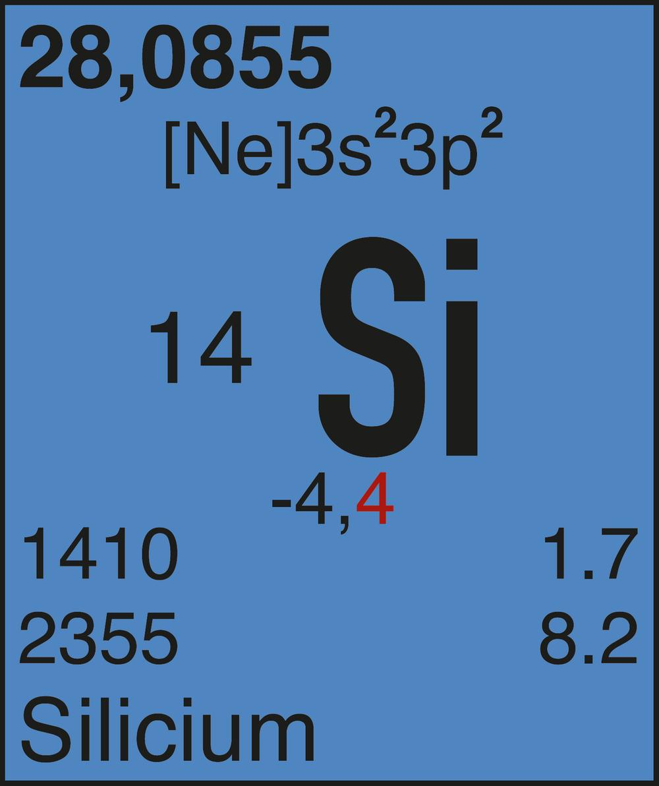
Introduction to Silicium
Silicium, also known as silicon, is a vital element that has played a crucial role in the development of modern technology. This abundant metalloid is a key component in semiconductor devices, solar cells, and countless other applications that power our digital world.

Slide 4
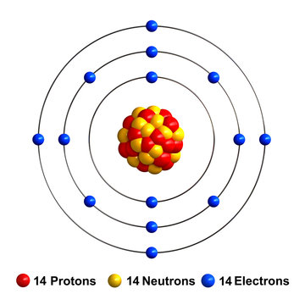
Atomic Structure and Properties
Silicium has a crystalline structure consisting of interlocking tetrahedra of silicon atoms.
It is a semiconductor with electrical properties that can be precisely controlled and tuned for various applications.
Silicium exhibits high thermal and electrical conductivity, as well as mechanical strength and hardness.

Slide 5
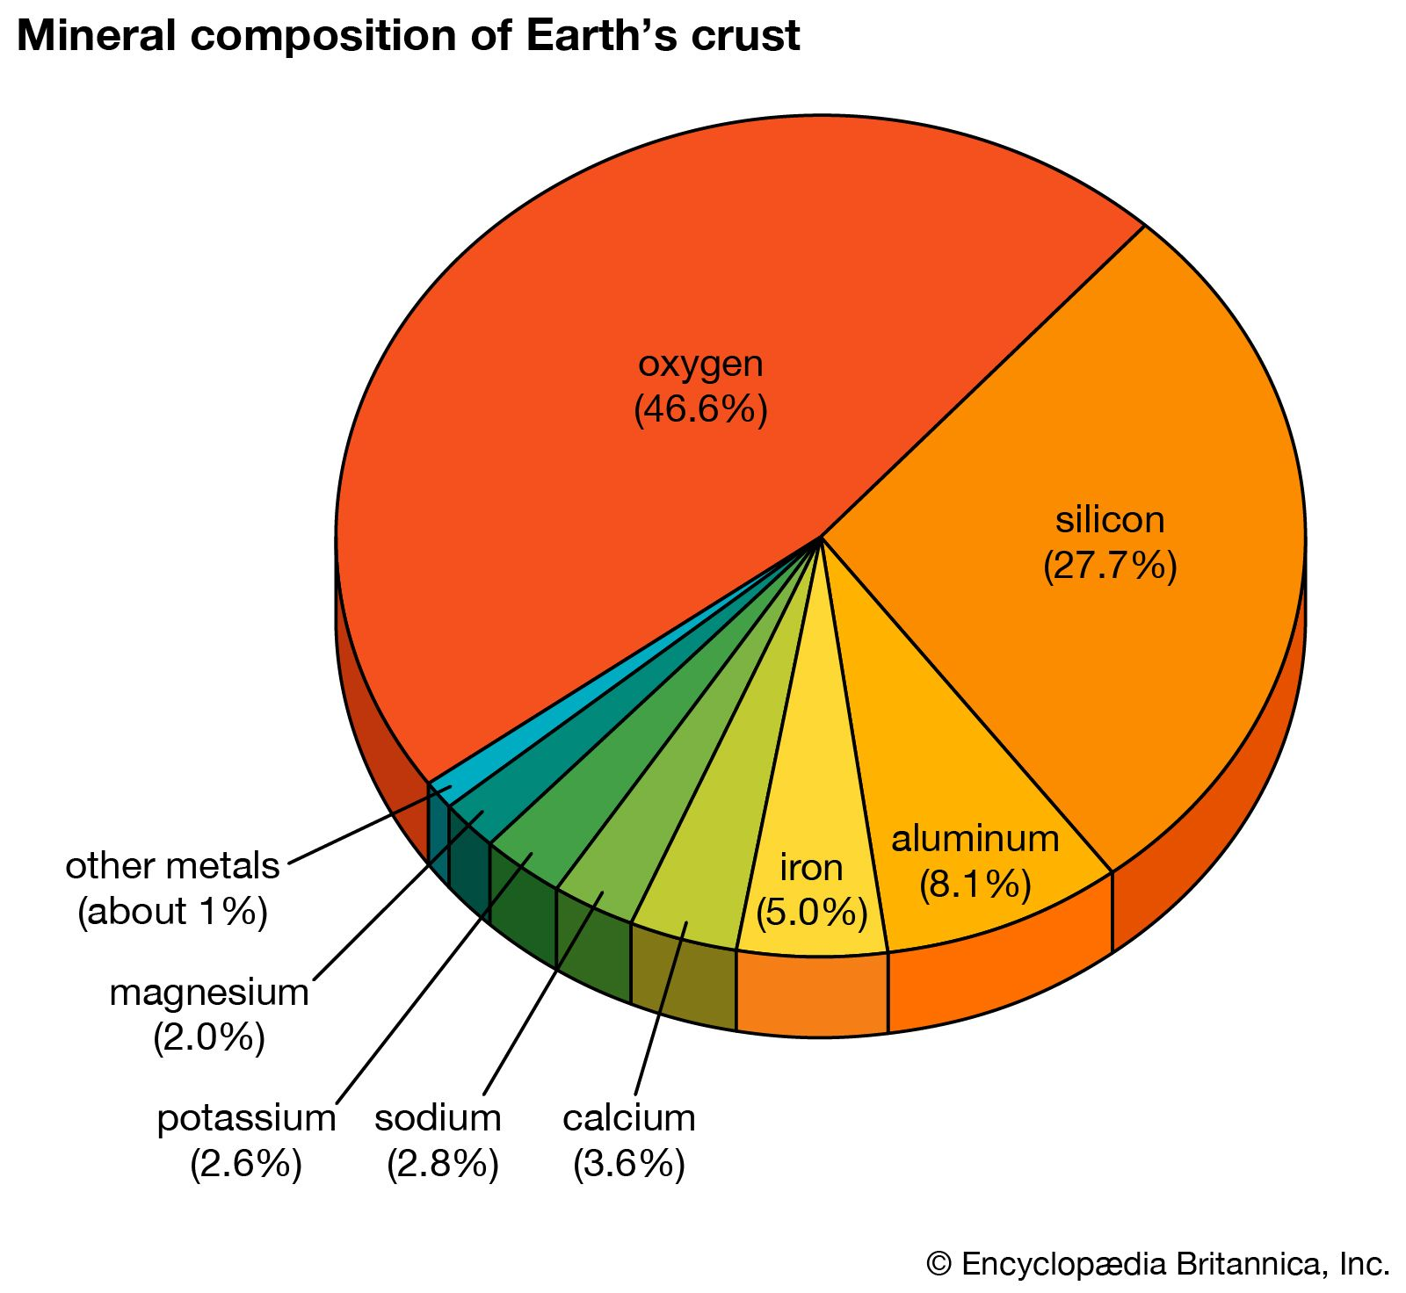
Occurrence and Abundance
Silicium is the second most abundant element in the Earth's crust, making up around 28% of its composition. It is primarily found in the form of silicon dioxide (SiO2), commonly known as quartz, sand, and rock.

Slide 6
Extraction and Purification
1
Mining and Extraction
Silicium is primarily extracted from quartz and sand deposits through mining operations, which involve mechanical and chemical processing to isolate the pure silicon.
2
Purification
The extracted silicon is then purified through a series of processes, including smelting, chemical reactions, and distillation, to remove impurities and achieve the high purity required for industrial applications.
3
Crystallization
The purified silicon is then melted and allowed to slowly crystallize, forming high-quality silicon ingots or wafers that can be used in the production of semiconductor devices and solar cells.

Slide 7
Crystalline and Amorphous Forms
Crystalline Structure
Amorphous Silicium
Applications
Production Methods
Crystalline silicium is widely used in semiconductor devices and solar cells, while amorphous forms find applications in thin-film electronics, coatings, and insulation materials.
Silicium can form a highly ordered, crystalline structure characterized by a repeating pattern of silicon atoms. This arrangement gives the material unique mechanical and electrical properties.
In contrast, amorphous silicium lacks the long-range atomic order of the crystalline form. It has a more random, glass-like structure, which results in different, often more flexible, characteristics.
Crystalline silicium is typically grown from molten silicon, while amorphous forms are often deposited using techniques like chemical vapor deposition or sputtering.

Slide 8


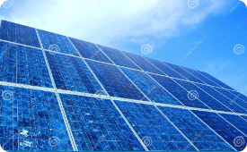
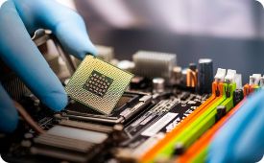
Applications in Electronics
Semiconductor Devices
Solar Cells
Sensors and Detectors
Computer Chips
Highly pure, crystalline silicium is a crucial material in the manufacture of efficient, cost-effective solar cells, driving the growth of renewable solar energy technology.
Silicium is the foundation of modern electronics, used extensively in integrated circuits, transistors, and microprocessors that power a wide range of electronic devices.
Silicium-based sensors and detectors are ubiquitous in modern electronics, enabling a vast array of applications from medical imaging to environmental monitoring.
The ability to precisely control the electrical properties of silicium has made it the foundation for the microprocessors and memory chips that power our computers and digital devices.

Slide 9

Uses in Solar Energy
Silicium is the backbone of the photovoltaic industry, powering the solar cells that convert sunlight into electricity. Its semiconductor properties and ability to absorb a wide range of the solar spectrum make it an ideal material for solar panel production.
Highly purified, crystalline silicium provides the foundation for efficient, cost-effective solar cells that are central to the growth of renewable energy technologies worldwide.

Slide 10
Silicium Compounds and Derivatives
Silicon Dioxide (SiO2)
Silicones
The most common silicium compound, found naturally as quartz, sand, and glass. It has widespread use in construction, electronics, and as a key ingredient in ceramics.
Synthetic polymers containing silicon-oxygen backbones. Used in sealants, lubricants, adhesives, and as key components in medical devices and personal care products.
Silicides
Silanes
Compounds of silicium with more electropositive elements like metals. Exhibit high melting points and hardness, making them useful in high-temperature applications and refractory materials.
Organosilicon compounds containing silicon-hydrogen bonds. Serve as precursors for producing silicium-based materials and as coupling agents in composite manufacturing.

Slide 11
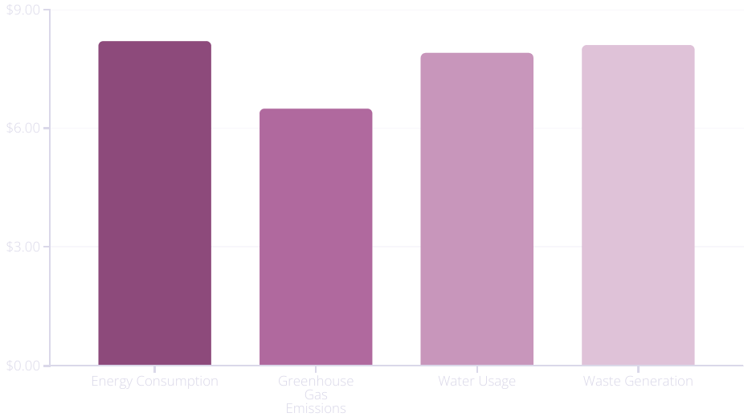
Environmental Impact and Sustainability
The widespread use of silicium has significant environmental implications. While silicium-based technologies enable advancements in renewable energy and electronics, the extraction and processing of the element can be energy-intensive and generate waste.
The industry is actively pursuing sustainable practices, including the use of renewable energy sources, water recycling, and waste minimization, to reduce the environmental impact of silicium production and processing.

Slide 12
Future Developments and Research
1
Advancements in Semiconductor Design
2
Emergence of Quantum Computing
Ongoing research aims to further miniaturize and optimize silicon-based transistors, enabling even more powerful and energy-efficient electronic devices.
Exploiting the unique quantum properties of silicon, researchers are developing revolutionary quantum computing technologies that could far exceed the capabilities of classical computers.
3
Enhanced Solar Cell Efficiency
4
Circular Economy Initiatives
Efforts are underway to develop sustainable recycling and reuse processes for silicon-containing materials, reducing waste and contributing to a more circular economy.
Scientists are exploring new silicon solar cell architectures and manufacturing techniques to boost the conversion efficiency of photovoltaic systems, driving down the cost of solar power.

Slide 13
Thank you for your attention!!!

